Slide 1
Lab 1 Introduction to XAMPP
United International College

Slide 2
Outline
XAMPP
Apache
MySQL
Import a database

Slide 3
XAMPP
XAMPP is a software package, which contains several services.
  Apache – Web server
  MySQL – Database server
  FileZilla – FTP server (for file transfer)
  Mercury – SMTP server (for emails)
  Tomcat – Web server with Java environment
In this course, we only need Apache and MySQL.
FileZilla is not used because the servers are installed on our own computers. We don’t need FTP software to transfer webpages to the server (what you have done in SDW1). Our computers are servers.

Slide 4
XAMPP control panel
The control panel of XAMPP is a special controller which allows users to config each component of the system.
To start XAMPP control panel,
  Click “start” button.
  Type “XAMPP control panel” to search the panel.
  Then, you will see the interface of the panel.

Slide 5
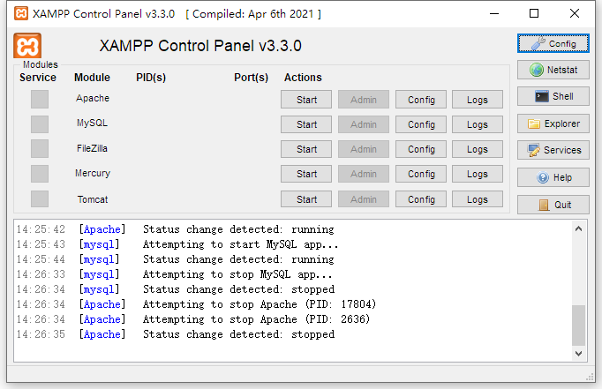
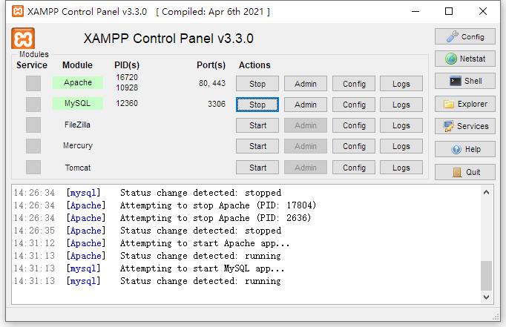
XAMPP control panel
To start Apache and MySQL, click “Start” for these two modules.
Once the services are started successfully, you will see the two modules are highlighted.
1
2

Slide 6


Apache
After you start the server, the “Admin” button is available.
Click “Admin” for Apache server. Then, there will be a pop-out webpage introducing XAMPP.
Note that this webpage is accessed via the Apache web server, but not opened directly from the local computer.
You can see this from the address bar of the browser.
If the webpage is opened by double-click from the hard drive, the address bar is
“C:/xampp/” is the location where Goliath installs XAMPP on his computer.

Slide 7
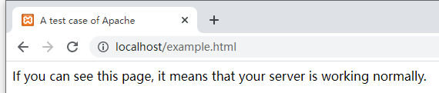
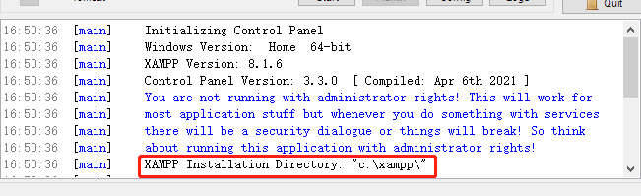
Apache
To publish a webpage, you need to put the webpage at “…/xampp/htdocs/”, where “…” is the directory of the system.
Copy and past “example.html” to “…/xampp/htdocs/”
Open your web browser and enter “localhost/example.html” into the address bar.
If everything is fine, then you are supposed to see the webpage.
To find where you install XAMPP, you can check the system dialog.

Slide 8
MySQL
Click the “Admin” button for MySQL. Then, there will be a pop-up webpage called “phpMyAdmin”.
“phpMyAdmin” is a web application (website) to let users access the database server with a graphical user interface.

Slide 9
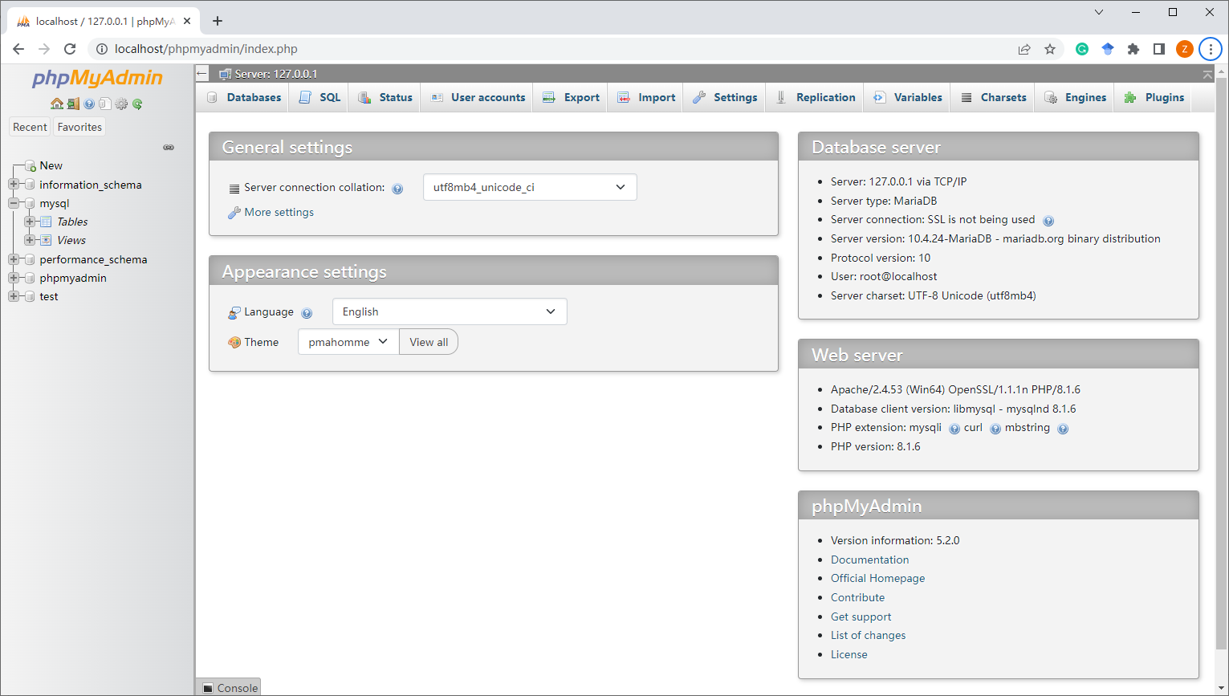
MySQL

Slide 10
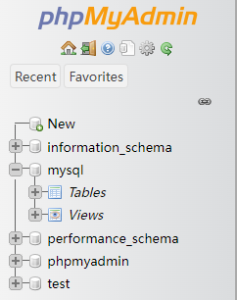
MySQL
On the left-hand side of the interface, there is a hierarchical database list to show all databases in the system.
You can click “+” in front of each database to show the content.

Slide 11
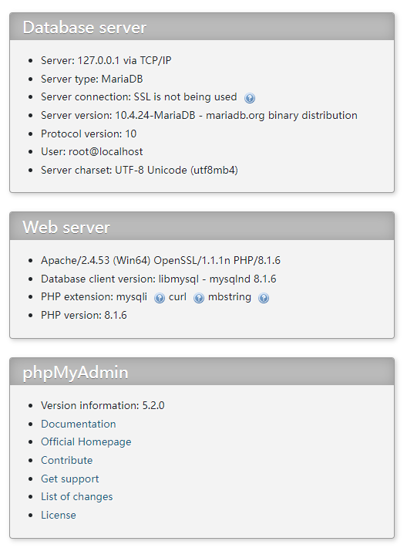
MySQL
System information is presented on the right.
You can check the versions.

Slide 12
MySQL
The menu bar is on the top.
  “Database”: to show all databases in the system.
  “SQL”: to let users write SQLs.
  “User accounts”: to show the users information. Administrators can manage user accounts here.
  “Export”: to let users export a table or a database from the system.
  “Import”: to import tables or databases from a local file.
  “Settings”: to setup the system.
Others are rarely used in this course.
1
2
3
4
5
6

Slide 13
Import
The labs of this course focus on a well designed and implemented sample database.
This database is in the file “sakila.sql”.
Note that this file is written in SQL. You can open the file and check the source code using a txt reader, for example Notepad.
To import the file,
  Click “import” in the menu bar;
  In the “File to import” section, click “choose a file”;
  In the pop out file explorer, locate “sakila.sql” and click “open”;
  Click “import” at the bottom of the page.
If everything works fine, the system will tell you “Import has been successfully finished”.

Slide 14
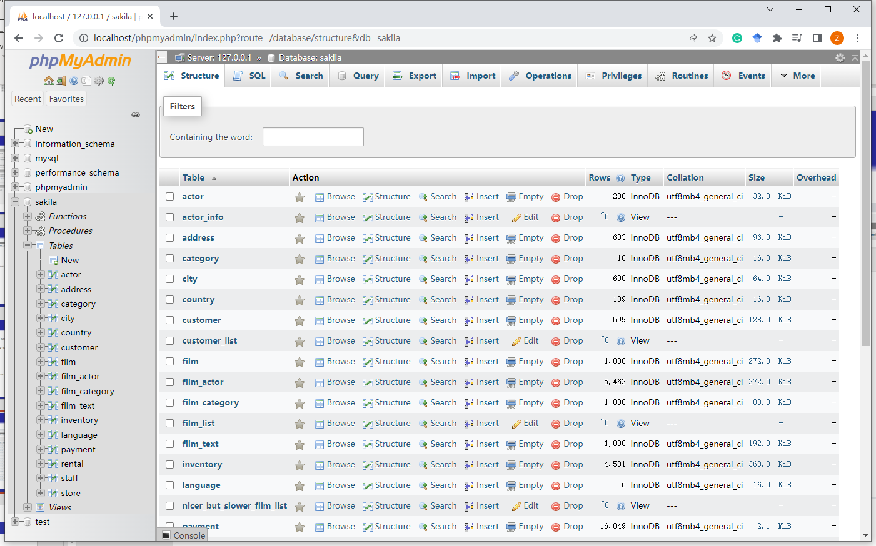
View a database
Click “sakila” in the database list to select the database.
All tables are shown on the page.
The options in the menu bar is changed to the functions can be done on one selected database.

Slide 15
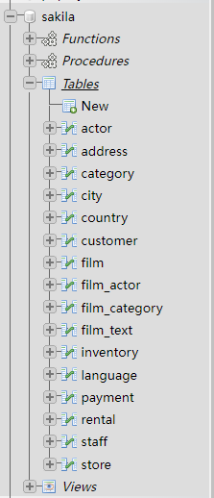
Basic Concepts
From the database list, one can see the database “sakila” has functions, procedures, tables, and views.
Each table contains a class of data of the same type.
For example, the table “actor” contains actors’ information.
A relational database consists of one or multiple tables.
Functions, procedures, and views will be introduced later in this course.

Slide 16
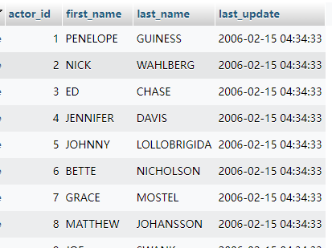
Basic Concepts
Select the “actor” table from the list.
All data in this table is presented in a tabular form.
Each row (also called tuple) is a set of information about one specific object.
  One row is about one actor in this example.
Each column (also called attribute) is about one type of data.
The schema of a table is the set of all attributes.
E.g. the schema of actor
actor=(actor_id,first_name,last_name,last_update)
The words “tuple” and “attribute” are also used in ER diagrams (in the lectures). They are different concepts, but with the similar meanings.

Slide 17
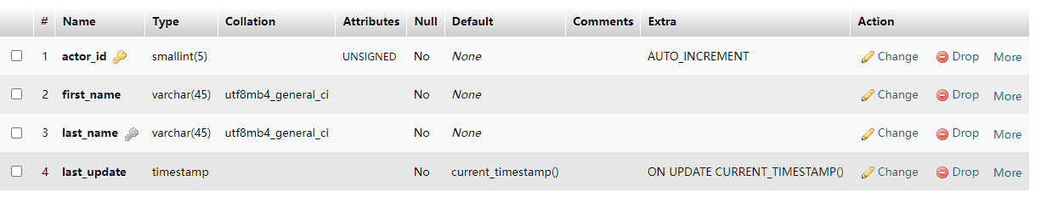
Structure Information
The schema of a table is also called metatdata, information about data.
Together with types, default values, etc., table structure is defined.
Click “Structure” to check the table structure.

Slide 18
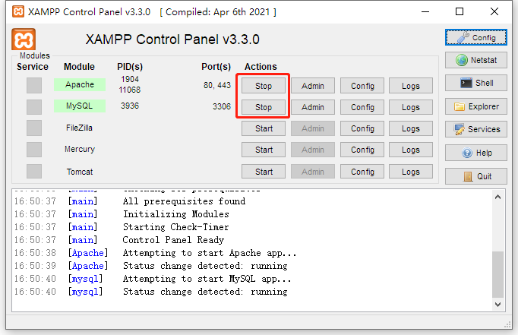
Stop services
SQLs will be introduced from the next lab.
After using the system, please remember to stop the servers.

Slide 19
End of Lab 1

